Slide 1
Concepts In Ethics

Slide 2
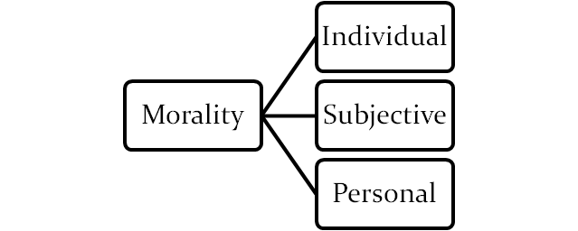
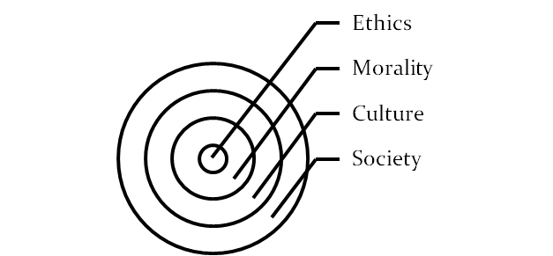
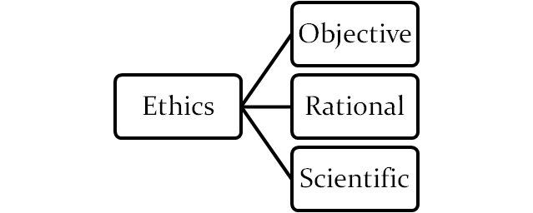
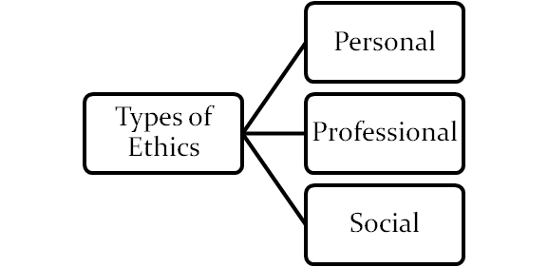
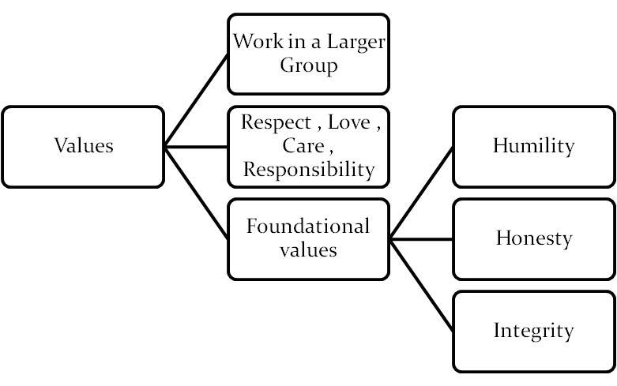
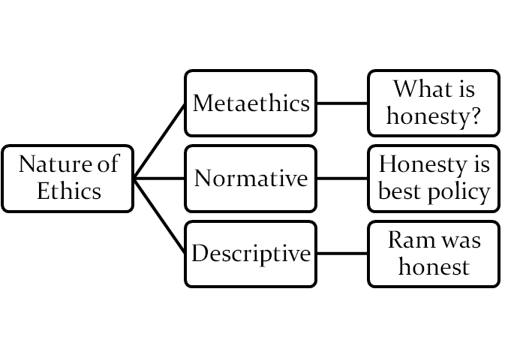
Ethics & Values-BELH-0006

Slide 3
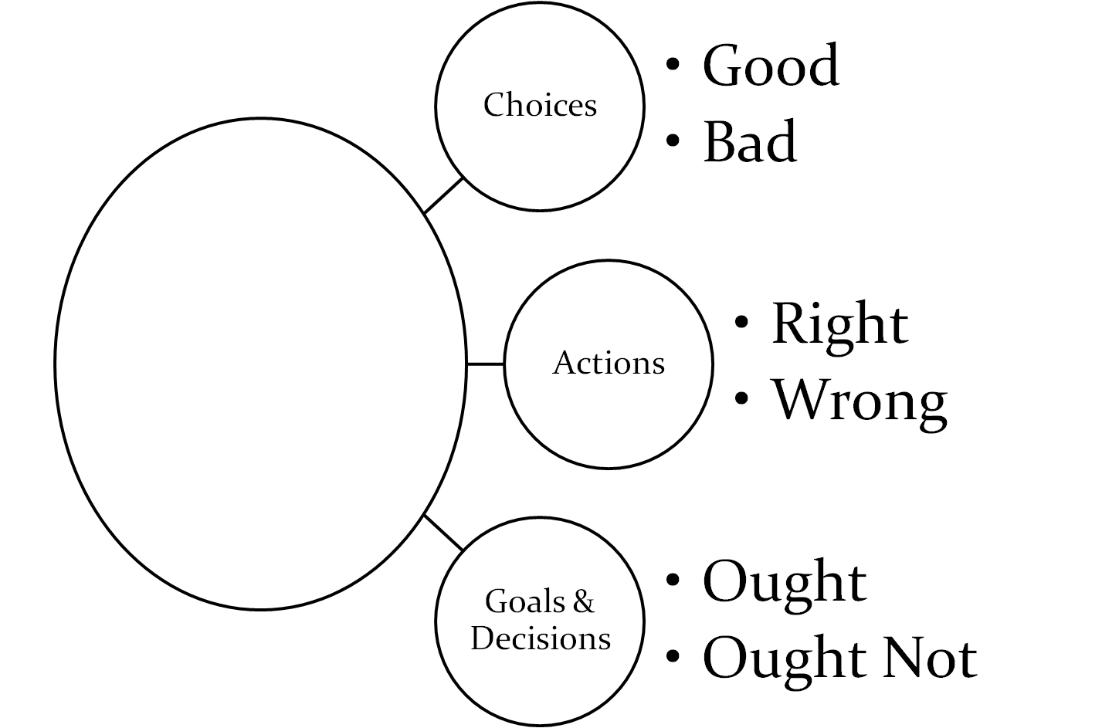
Ethical/ Decision Making

Slide 4
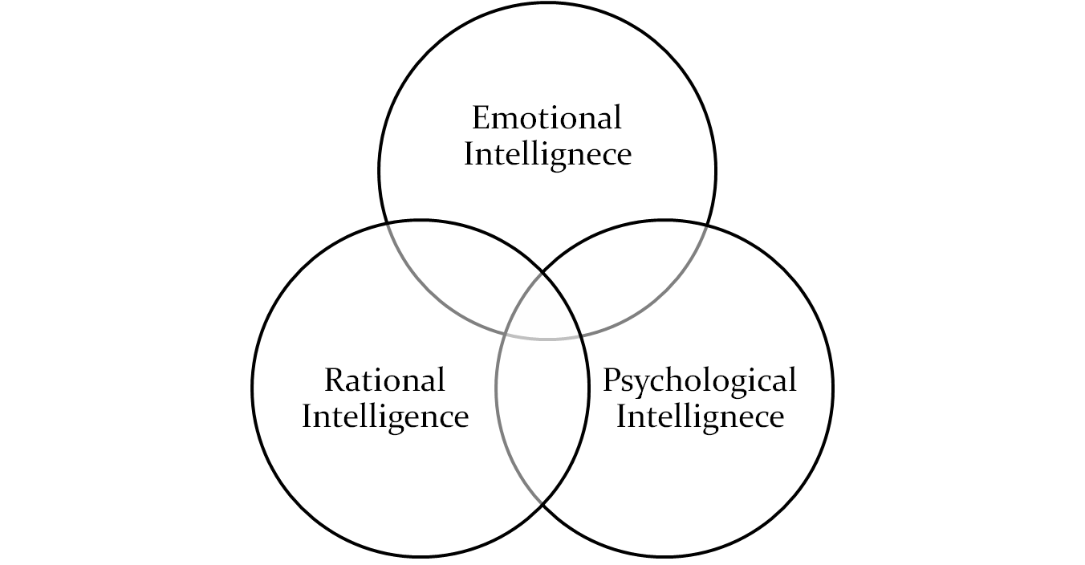
Intelligences: Ethical Intelligence EDM+PPP MODEL

Slide 5
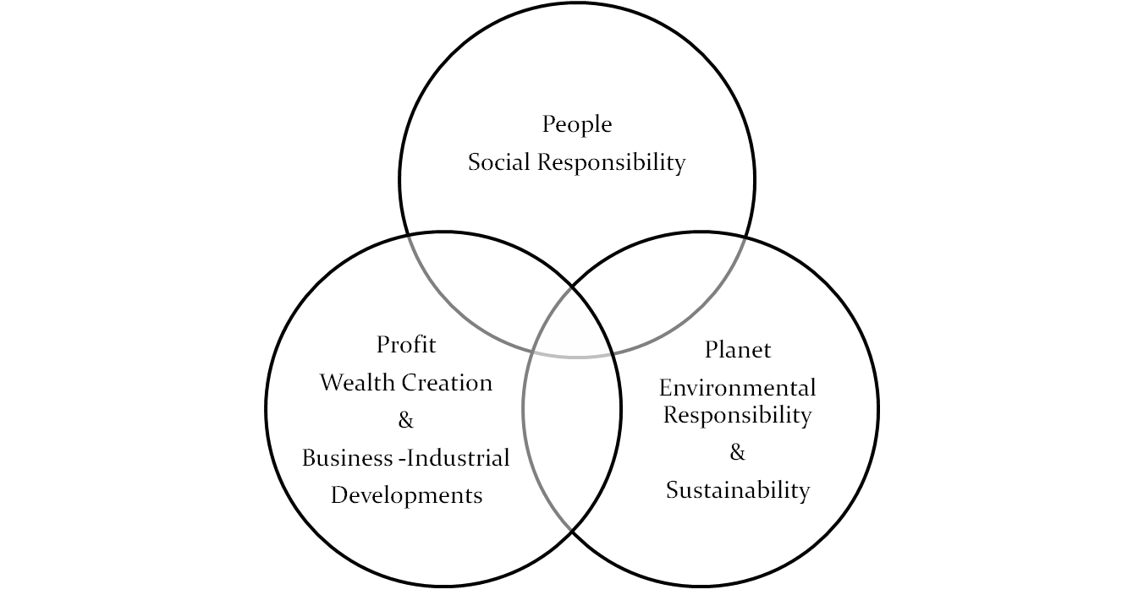
Triple P Model : People Planet and Profit

Slide 6
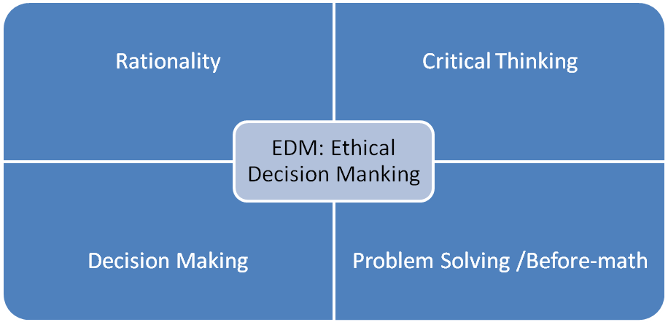
EDM: ETHICAL DECISION MAKING

Slide 7
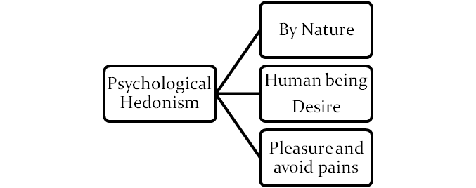
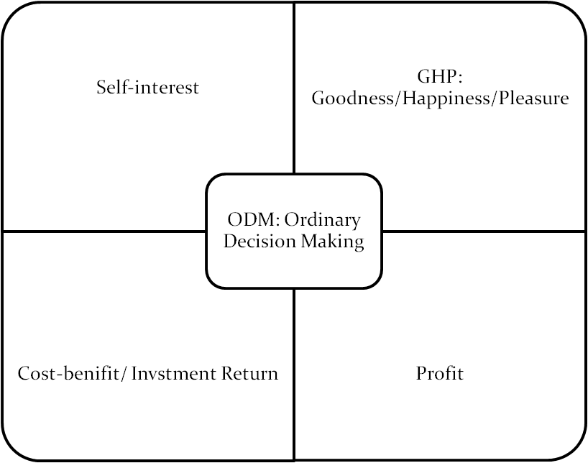
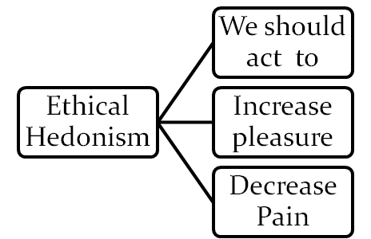
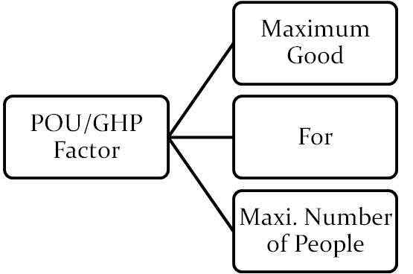
ODM: ORDINAORY DECISION MAKING, Psychological Hedonism , Ethical Hedonism and Principle of Utility

Slide 8
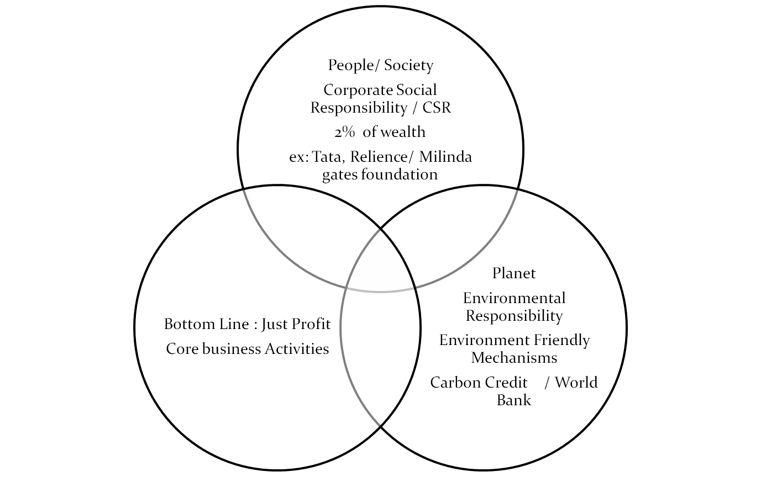
5 Ps Model: Individual and Social / Professional/ prosperity & Peace

Slide 9
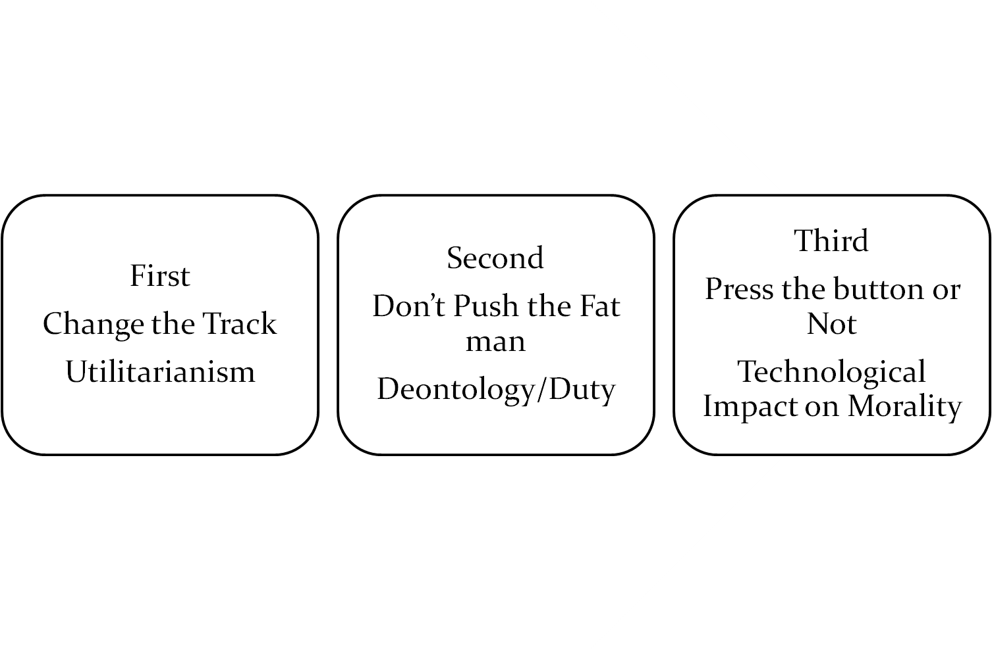
Runway Trolley Problem: Three Versions and Majority Decisions

Slide 10
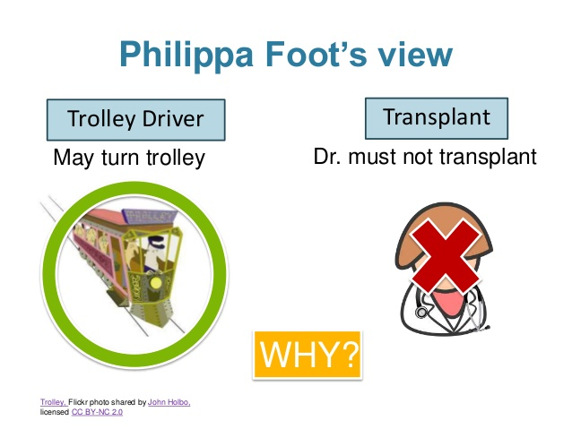
Trolley Problem: First Version
10

Slide 11
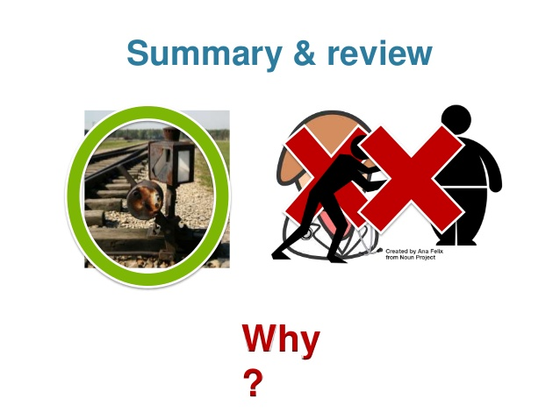
Trolley Problem: Second Version
11

Slide 12
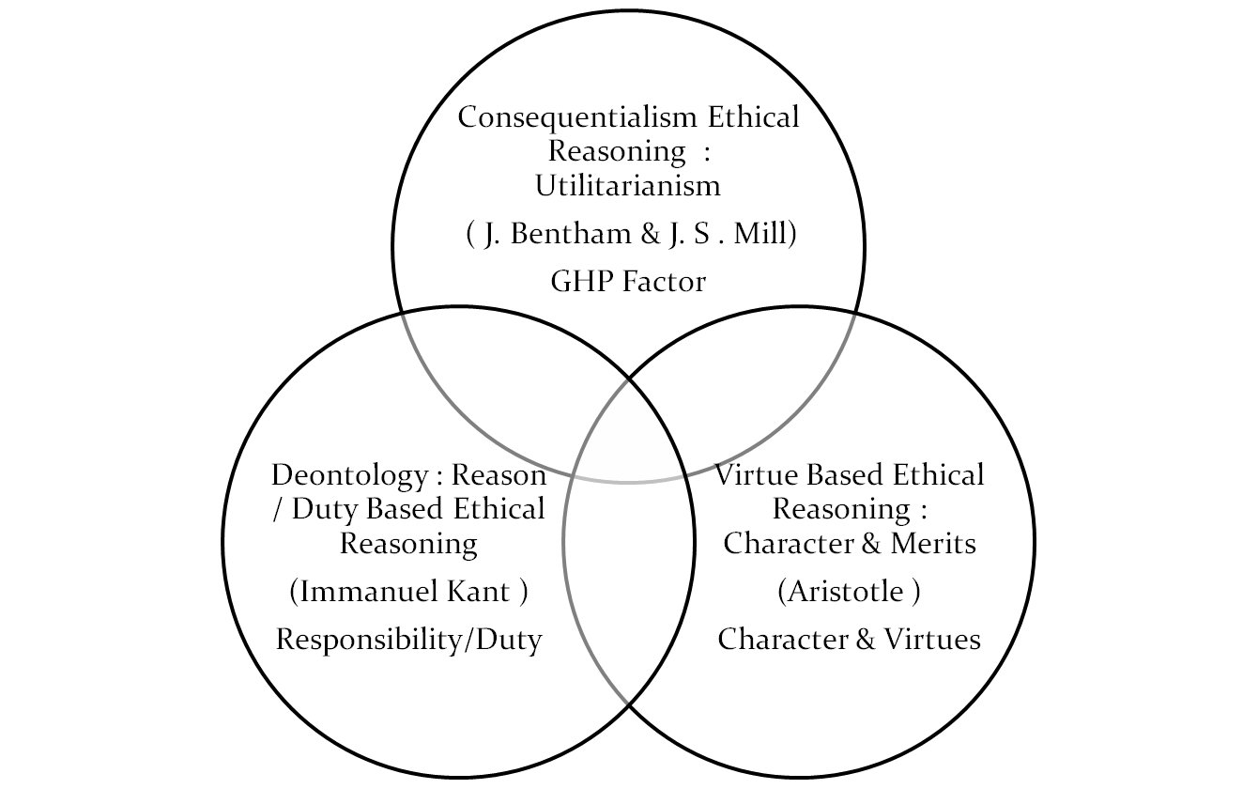
Prominent Models of Ethical Reasoning

Slide 13
Case Studies: 1
: The Case of Privacy
Marcus is a computer engineer who has recently developed an app which helps users keeps track of medical information, doctor’s appointments, and prescriptions.
Information about the user is stored in this app, including what prescriptions they are taking and how frequently they schedule doctor’s appointments. As the developers of the app, Marcus and his company have access to this information.
The marketing department requests Marcus supply them with customer-specific information so they can better target ads and app suggestions to the users. Marcus understands that he is part of a company, but also feels that the privacy of the app users should be protected. Additionally, Marcus feels that as an engineer, he should be responsible to those who use his technology.
Ethical Questions:
How does Marcus determine how much of the user’s information should be shared with marketing?
Is this an ethical use of information or a violation of the user’s privacy?

Slide 14
Case Study: 2
Love & Profession: Ethical Dilemma Personal & Professional Ethics Sumati loves Ranjan since they both were undergoing training as Computer professionals in a same company. After their training, they were posted as software engineer to two subdivision offices. They both stayed together at the district. The office where Ranjan worked was rich in connection with many bribing contractors and clients.
Sumati came to know that Ranjan was getting tempted by bribe offers offered by contractors to overlook certain software quality issues. She observed that he was bringing costly gifts for her. One day she confronted him but he told her that he was not doing anything illegal and some rich people impressed by his working style were being just very generous in spite of his reluctance to receive anything from them. He was also attending parties thrown by some rich contractors in the district.
Sumati was now growing uncomfortable with Ranjan’s attitude. They both love each other very much; in fact it was Sumati who had proposed him first.
One day she came to know conclusively that Ranjan had taken bribes from some people. She also comes to know that the favour for which Ranjan has compromised would create a great loss to company. She is upright software professional and has made herself a good name.

Slide 15
Questions
If she takes a drastic step, it might endanger her love and future marriage.
Should Sumati break-up and put the profession first?
Would Ranjan be a right person to marry Sumati?
What should Sumati do knowing her beloved is involved in bribing and her future love-marriage might get jeopardized if she takes a drastic step?

Slide 16
Contemporary Ethical Issues
Universal Basic Income
Lock Down and Social Distancing
Vaccination and Social Challenges

Slide 17
Important Video Links
Ethical Dilemma: Dog and Master
https://www.youtube.com/watch?v=zG7PPOaJnNM
Runway Trolley Problem
https://www.youtube.com/watch?v=yg16u_bzjPE
Humility
https://www.youtube.com/watch?v=55WC5G9mj0Y&t=4s
Honesty
https://www.youtube.com/watch?v=-L1IekaejfU&t=4s
Integrity
https://www.youtube.com/watch?v=cW8LBJxLPG0&t=3s
Universal Basic Income
https://www.youtube.com/watch?v=W2Xv_9vSDE8&t=3s

Slide 18
Video Links
Pandemic Ethics
https://www.youtube.com/watch?v=_fi3rxxrK7I
https://www.youtube.com/watch?v=gurZcyLwybI

Slide 19
Prominent Models of Ethical Reasoning

Slide 20
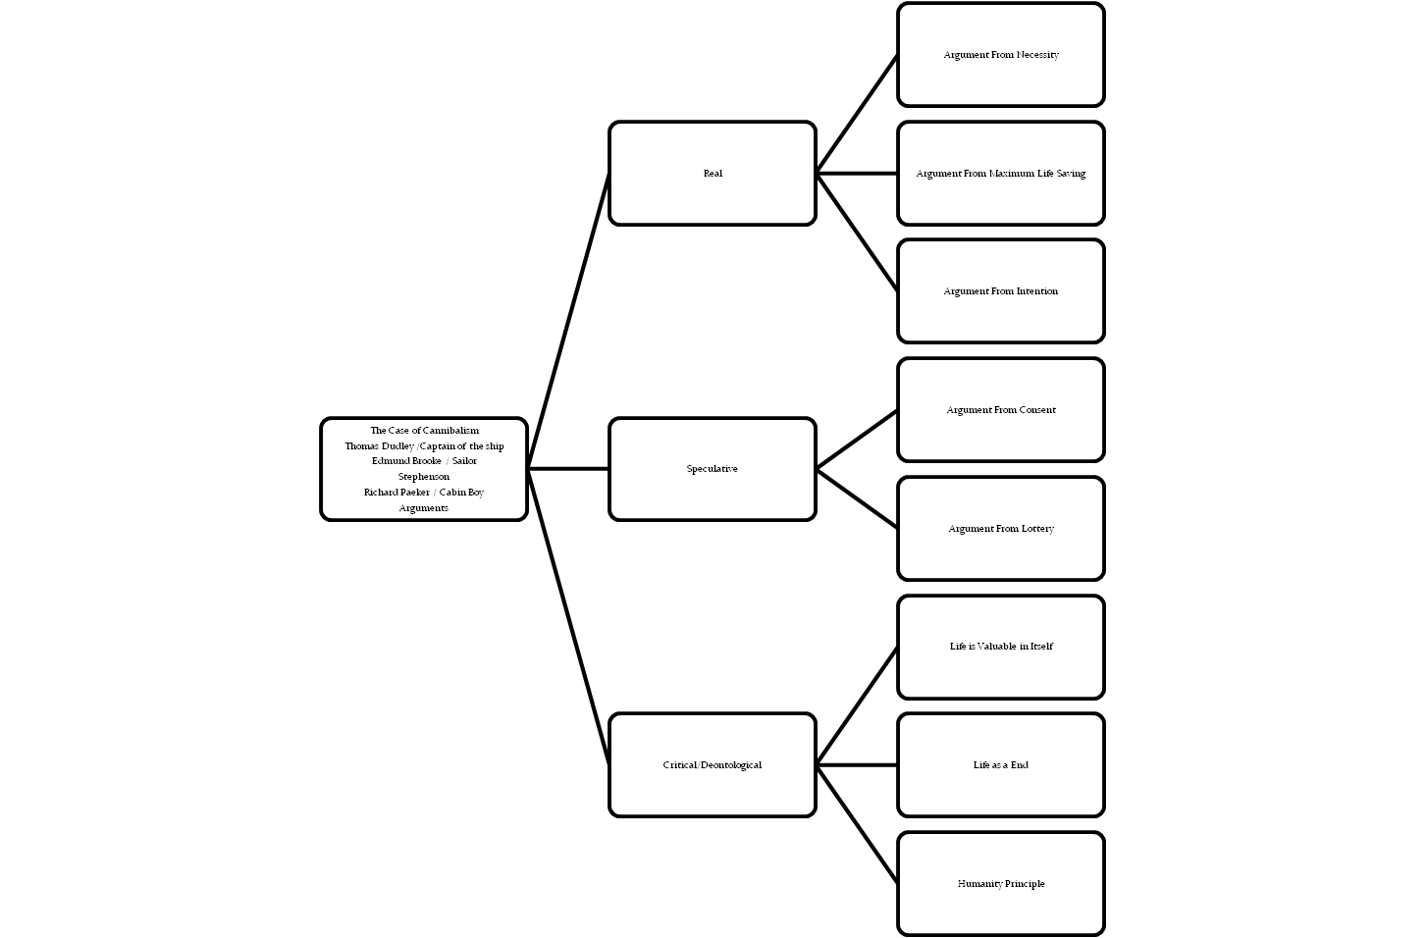
The case of Cannibalism/ Queen Vs Dudley Stephenson

Slide 21
Documentary: Story of Stuff
https://www.youtube.com/watch?v=9GorqroigqM
How do your personal ethics impact on environmental ethics?

Slide 22
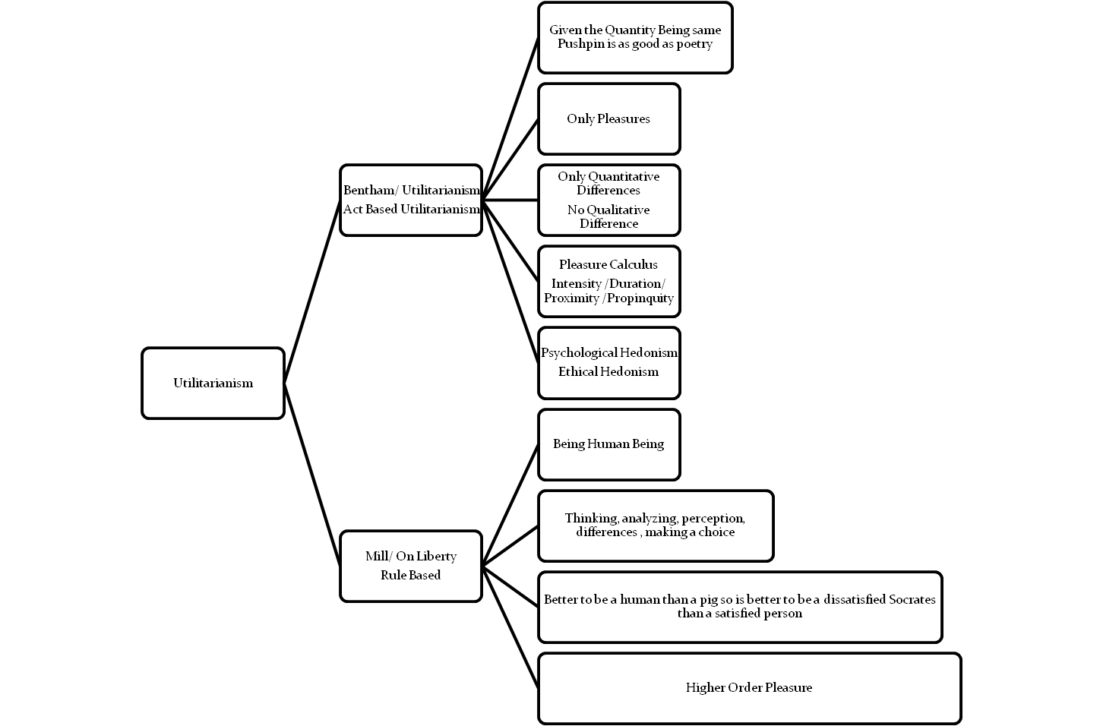
Utilitarianism : Bentham & Mill

Slide 23
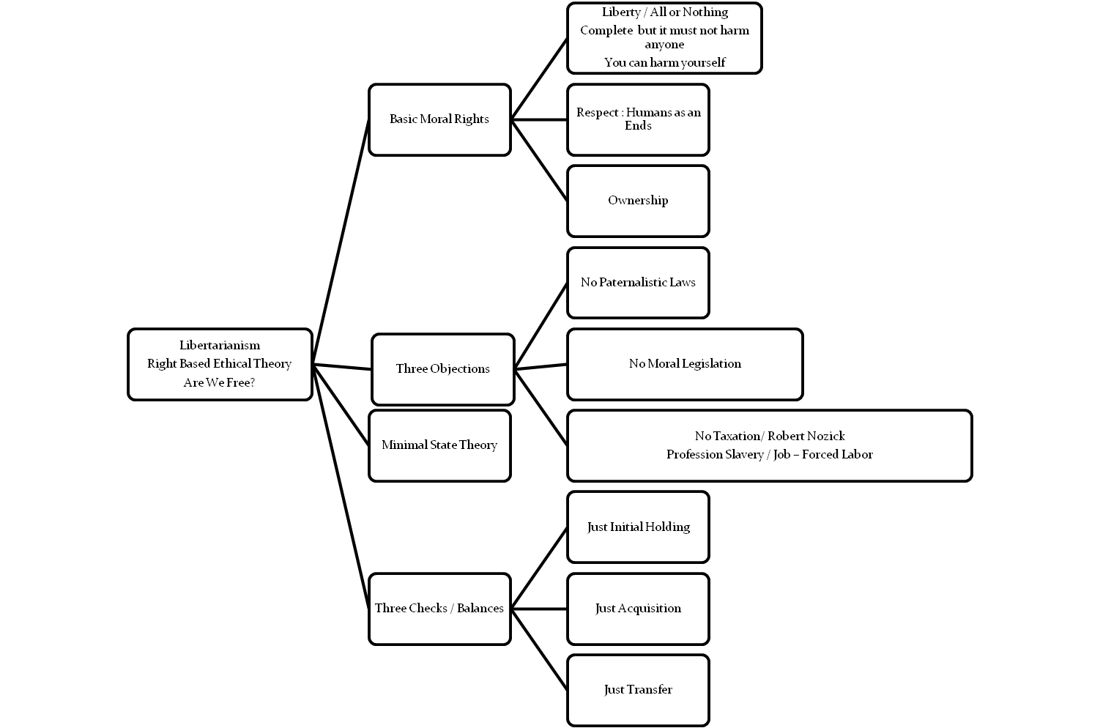
Libertarianism

Slide 24
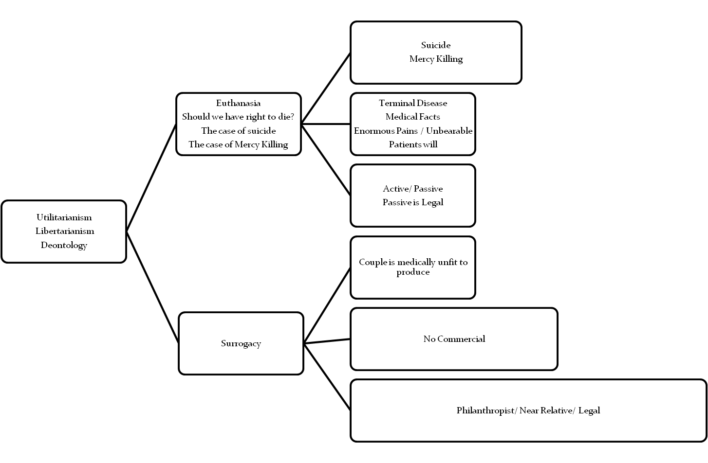
Euthanasia & Surrogacy

Slide 25
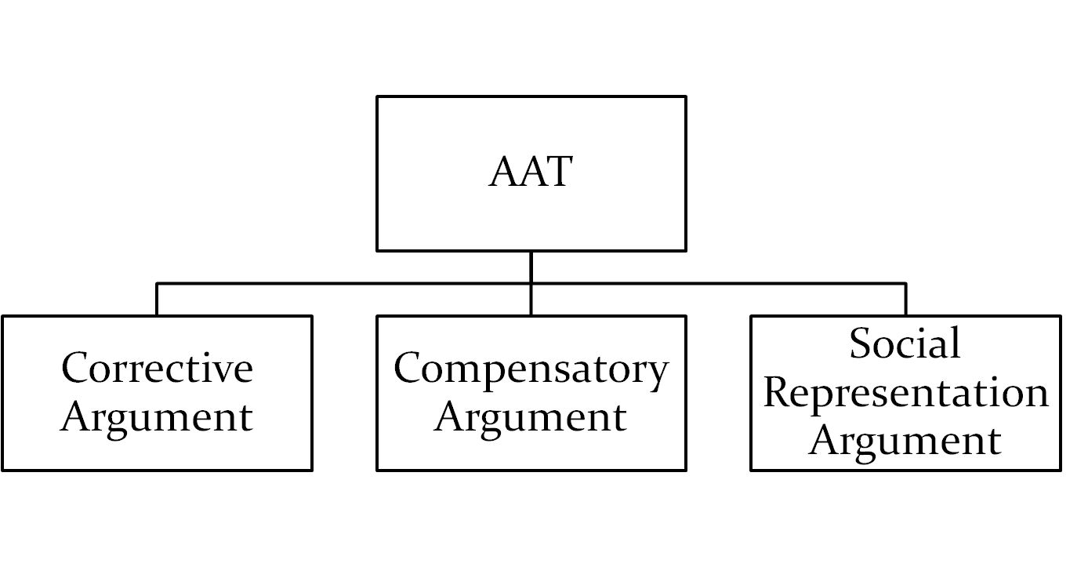
Affirmative Action Theory (AAT)

Slide 26
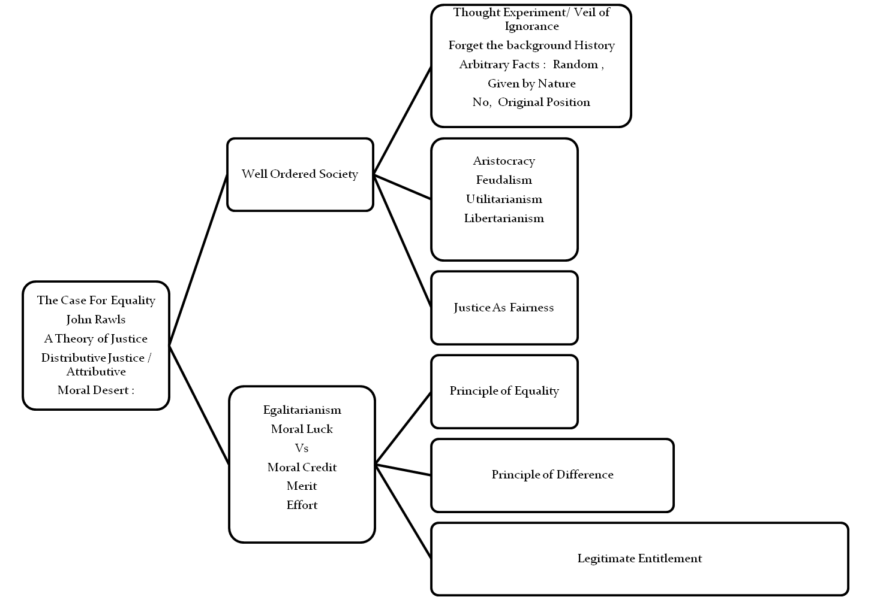
A Case For Equality: Rawls Theory of Justice
Notes:
26

Slide 27
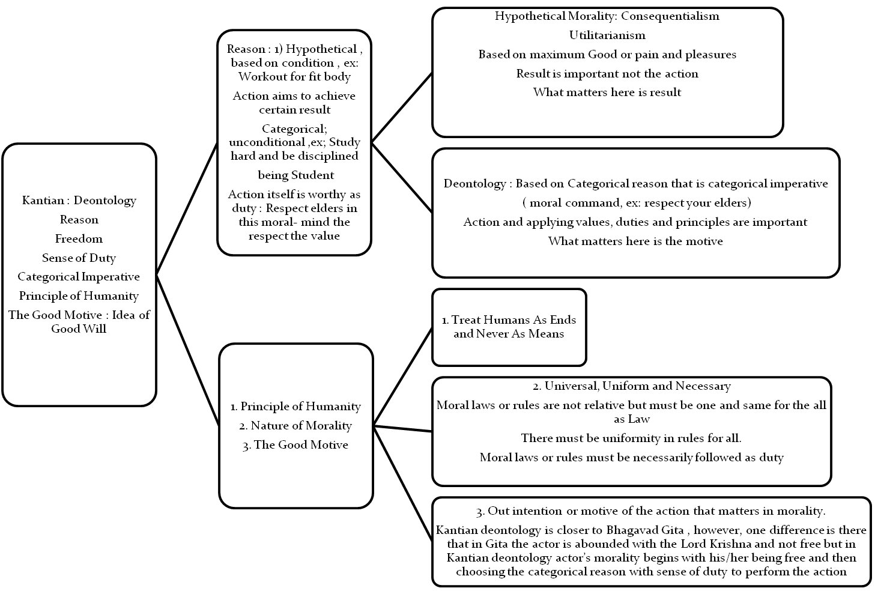
What Matters Is Motive: Deontology
Notes:
27

Slide 28
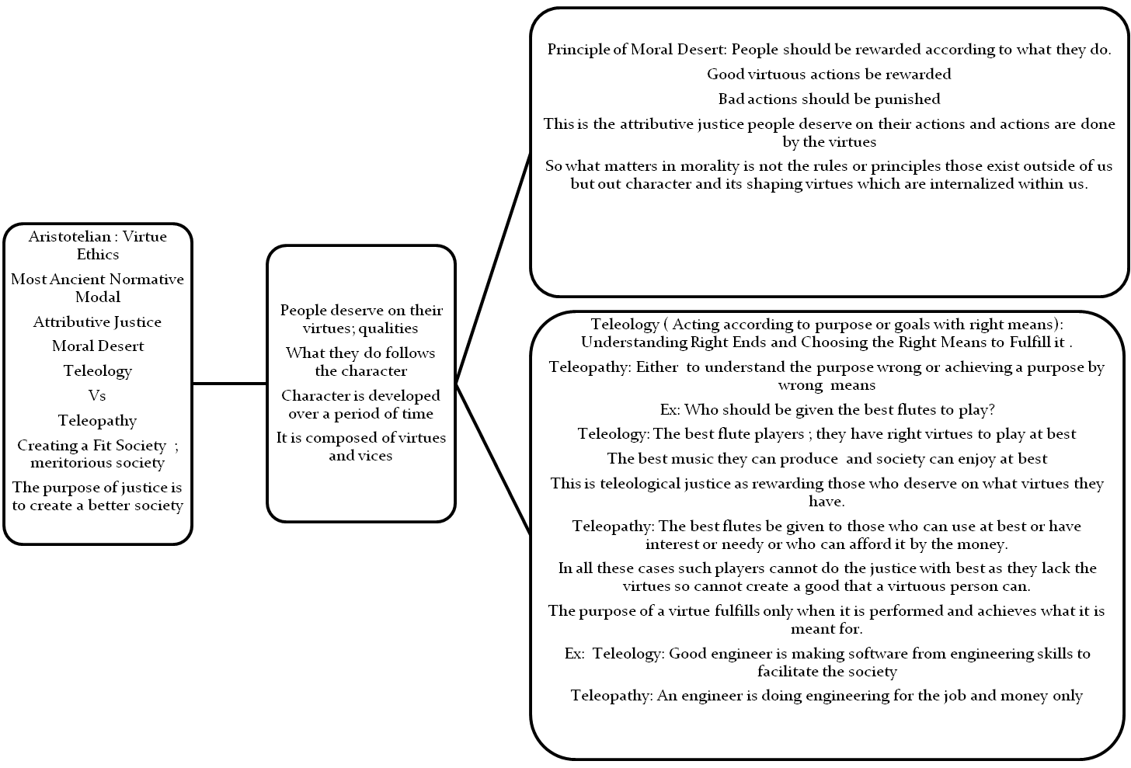
Who Deserves What: Aristotelian Virtue Theory
Notes:
28

